Slide 1
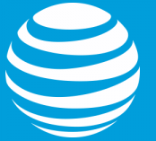





Team 2: Connecting With Content
Daniel McCartney
M.B.A.
Sushmita Suresh Rao
M.S., Computer Engineering
Ying-Chu Lo
M.S., Analytics

Slide 2
The Solution
Use AT&T’s IOT to create the first-ever social remote viewing program.
$1.6 billion in additional revenue over 5 years
4.5 million additional subscribers within 5 years

Slide 3
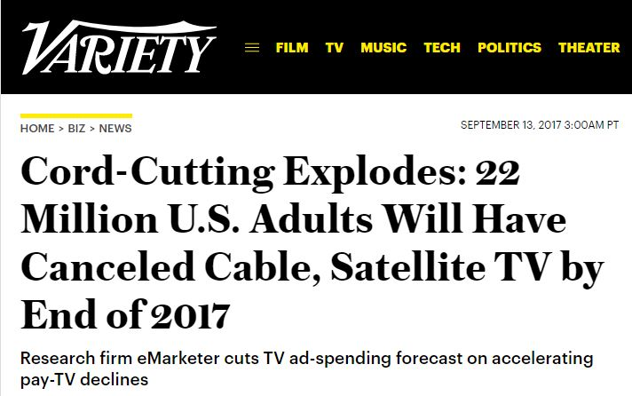
Cord Cutting
33.2% increase from 2016 to 2017
By 2021, 81 million Americans will not have cable or satellite.
85% of cord cutters do so because of cost.
Notes:
https://techcrunch.com/2017/09/13/56-6-million-u-s-consumers-to-go-without-pay-tv-this-year-as-cord-cutting-accelerates/
https://www-statista-com.libproxy2.usc.edu/statistics/305416/cord-cutting-reasons/

Slide 4

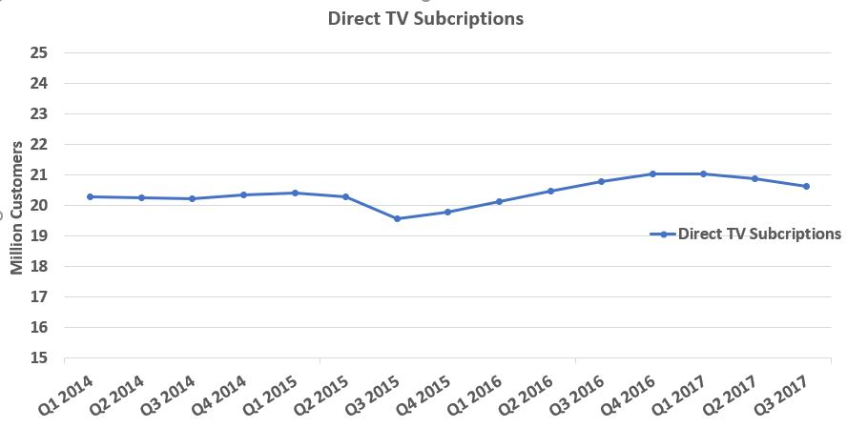
Flat subscription growth
Q1-Q3 2017: 400,000+ subscribers left DirecTV

Slide 5
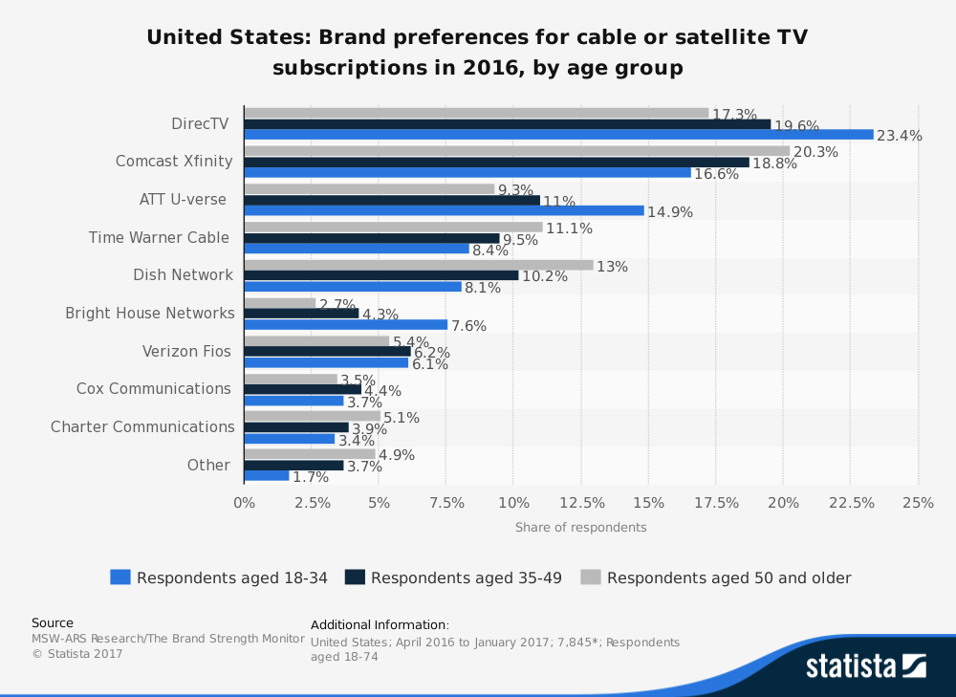
DirecTV Is the Most Popular Provider

Slide 6
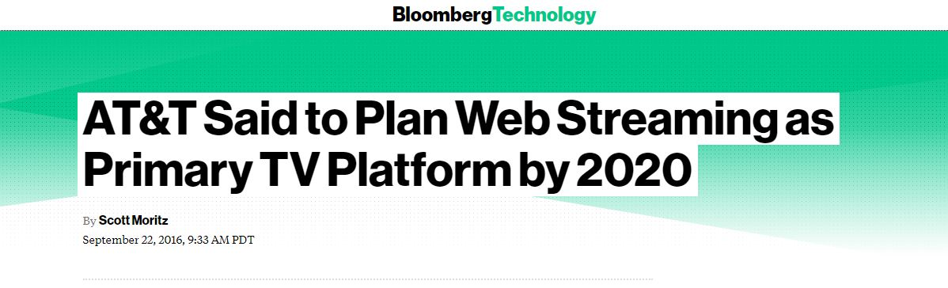
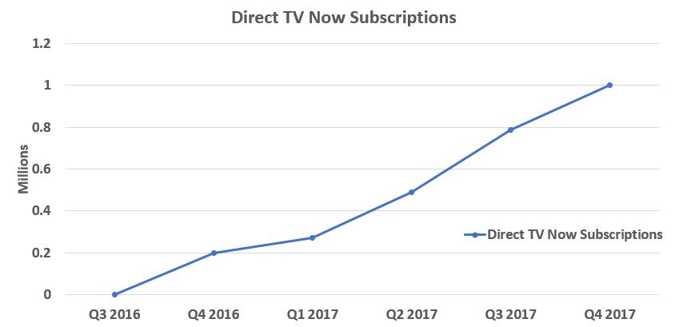

Slide 7
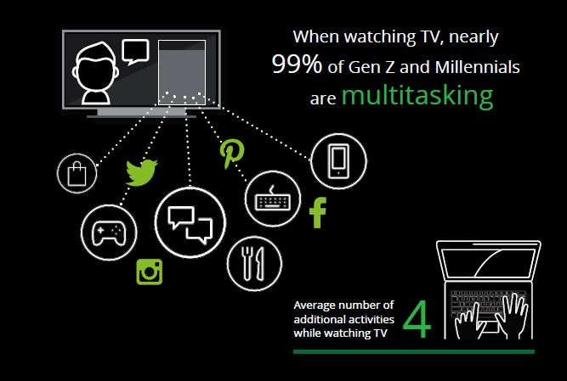
“Our strategy is to create the best entertainment and communications experiences in the world.”
RANDALL STEPHENSON
Chairman, Chief Executive Officer and President

Slide 8

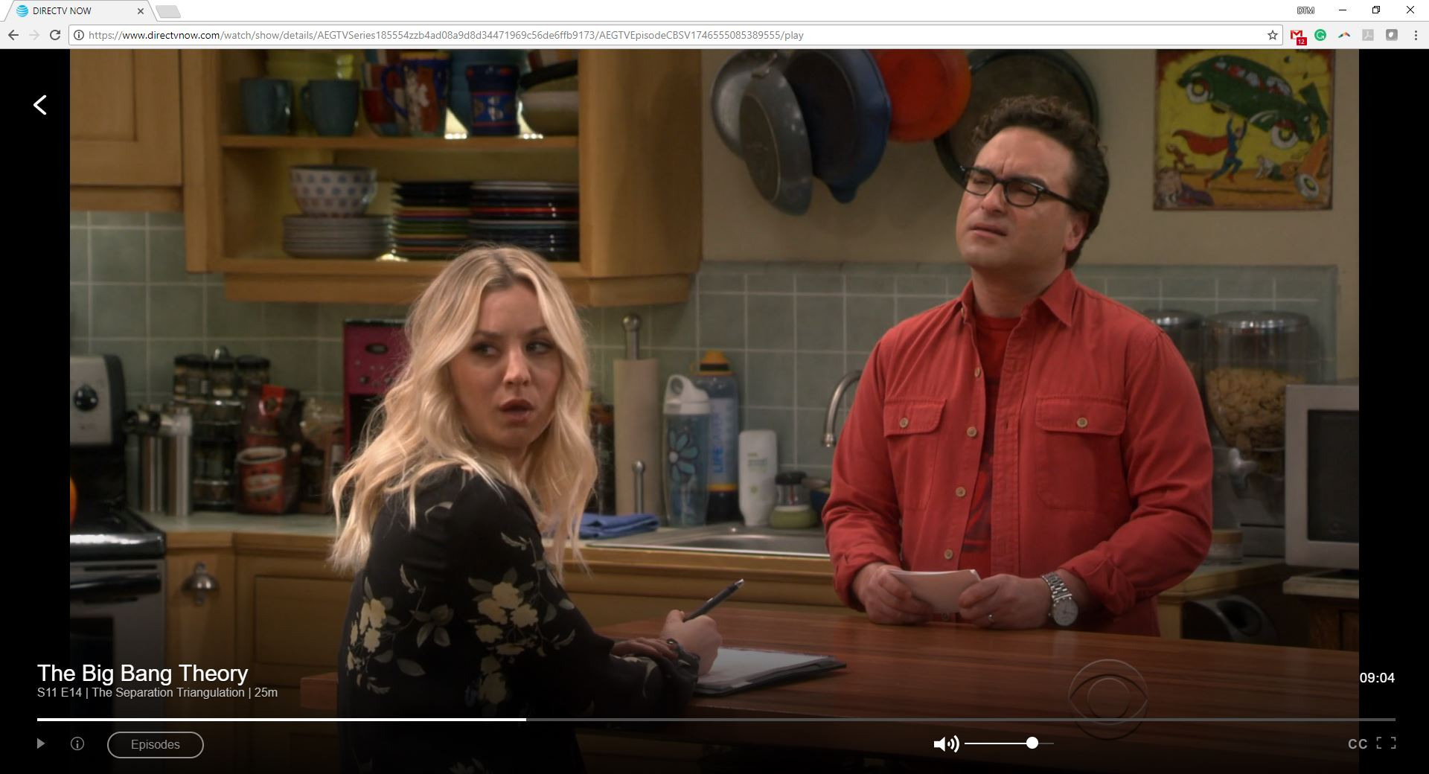


DirecTV Connect

Slide 9
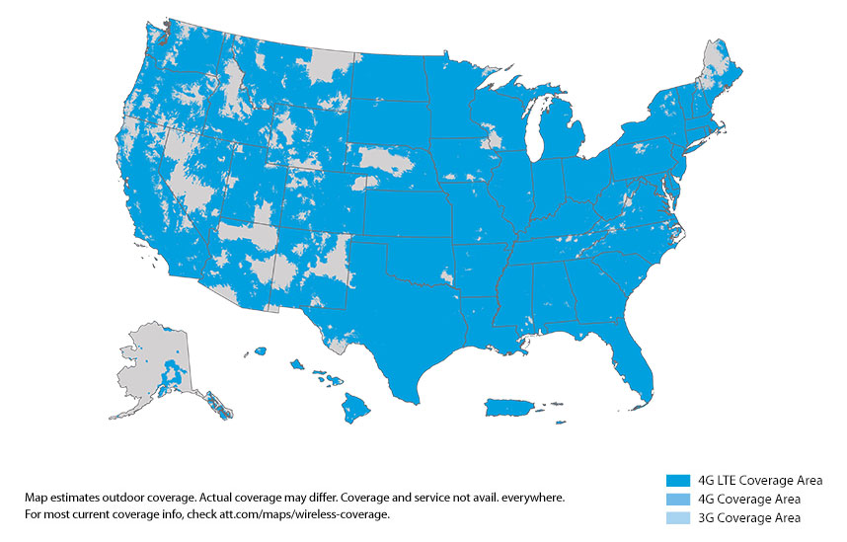



DirecTV Connect
Use AT&T’s expertise in connectivity to let subscribers watch together no matter where they are.
Connect using two screens or one through a network of AT&T-supported devices.

Slide 10
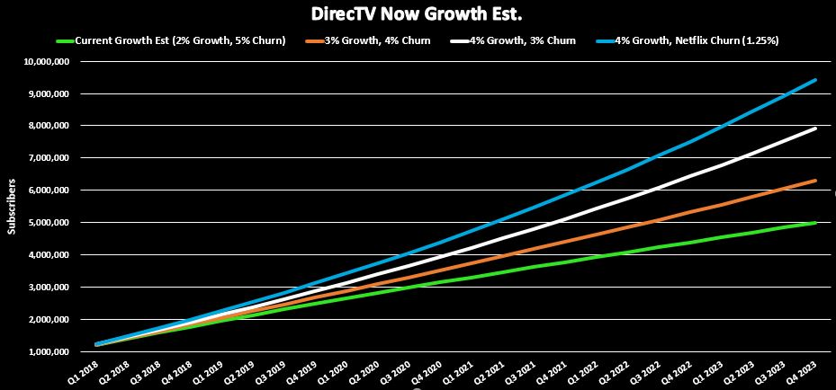
4.5 Million
Notes:
Churn Rate Est. Cabel 1% Netflix 5% Amazon 19% Hulu 50% Direct TV Now Est 19%

Slide 11
Real-Time APIs
The real-time API lets the developer design a shared data model that looks just like a local, in-memory data model.
These collaborative data model objects work just like local in-memory data model objects, with one exception.
Today’s users expect real-time experiences. Think: Facebook Messenger, Google Docs, Uber, etc.
Every application has real-time data, so why not expose it via a real-time API? You can get valuable data into apps faster, share it with customers, and empower them to build amazing — and proven-popular— real-time user experiences.

Slide 12
What We Built
Demonstrated using two local machines communicating over Facebook API
Synchronization code written using Python
Can use icon to trigger synchronization
Code detects icon in real time
Redirection achieved to YouTube with video resumed in full screen
Can extend this capability to pause and play synchronously
Can also extend capability to include FaceTime and chat window on DirecTV

Slide 13
Flowchart for Front End & Back End
USER INTERFACE:
IDLE PROCESS
SEND THE ICON
PAGE REDIRECTS TO VOD
RESUME PLAYING IN FULL SCREEN
BACKEND:
USE CPU CYCLES BY TAKING CONTINUOUS SCREENSHOTS
DETECT FOR OCCURRENCE OF THE ICON
OPEN YOUTUBE TAG PAGE
CLICK ON HOTKEY ‘F’, ‘O’, ‘K’

Slide 14
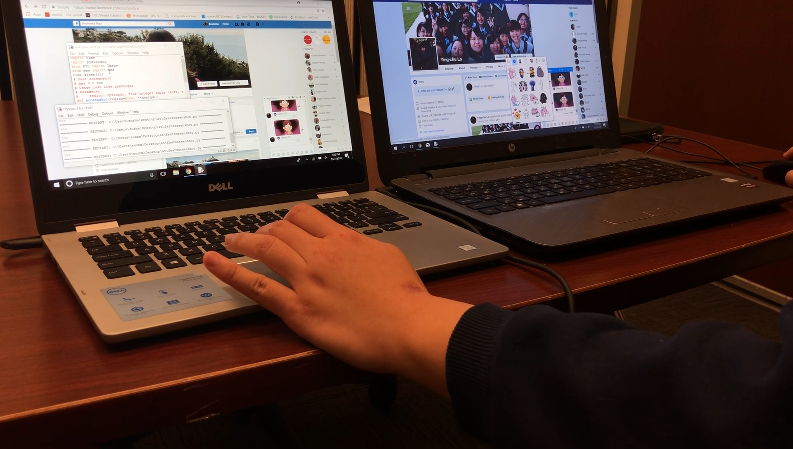

Slide 15
Risks
Real-time application programming interfaces are subject to latencies of various kinds and orders.
Processor type, operating system type, and number of background processes need to be taken into consideration when designing the API.
Applications for which ordering and sequencing are important are not suited for real-time API usage.
Internet speeds play a major role in real-time applications. Variations in speed can lead to distortion and performance losses.

Slide 16
Conclusion
Use AT&T’s IOT to create the first-ever social remote viewing program.
$1.6 billion in additional revenue over 5 years
4.5 million additional subscribers within 5 years

Slide 17
Q & A
Daniel McCartney
M.B.A.
Sushmita Suresh Rao
M.S., Computer Engineering
Ying-Chu Lo
M.S., Analytics

Slide 18
https://www.theverge.com/2017/12/5/16737646/directv-now-1-million-subscribers
https://www.fool.com/investing/2017/10/16/where-are-all-these-directv-now-subscribers-coming.aspx
https://otp.tools.investis.com/clients/us/atnt/SEC/sec-show.aspx?FilingId=12360123&Cik=0000732717&Type=PDF&hasPdf=1
https://investors.att.com/~/media/Files/A/ATT-IR/financial-reports/quarterly-earnings/2016/4q-2016/form-8-k.pdf
http://www.einnews.com/pr_news/321428028/parks-associates-announces-update-to-ott-subscriber-churn-rates-for-netflix-hulu-and-amazon-users
http://www.businessinsider.com/directv-now-profit-margins-chart-2016-11
https://www.mediapost.com/publications/article/273608/netflix-has-low-churn-rate-among-top-ott-service.html?edition=
https://www-statista-com.libproxy2.usc.edu/statistics/305416/cord-cutting-reasons/
https://www2.deloitte.com/us/en/pages/technology-media-and-telecommunications/articles/digital-democracy-survey-generational-media-consumption-trends.html
https://www.pwc.com/gx/en/industries/entertainment-media/outlook.html

Slide 19
Subscriber Sensitivity Table
Quarterly Growth Rate
 | 2% | 3% | 4% | 5% | 6% | 7% | 8% | 9% | 10%
5.0% | 4,993,590 | 5,732,005 | 6,601,198 | 7,624,766 | 8,830,502 | 10,251,110 | 11,925,050 | 13,897,514 | 16,221,562
4.5% | 5,243,671 | 6,003,197 | 6,896,226 | 7,946,738 | 9,182,959 | 10,638,093 | 12,351,169 | 14,368,027 | 16,742,468
4.0% | 5,513,013 | 6,294,631 | 7,212,572 | 8,291,210 | 9,559,217 | 11,050,308 | 12,804,096 | 14,867,086 | 17,293,841
3.5% | 5,803,335 | 6,608,081 | 7,552,072 | 8,660,081 | 9,961,244 | 11,489,799 | 13,285,956 | 15,396,905 | 17,877,986
3.0% | 6,116,517 | 6,945,488 | 7,916,728 | 9,055,426 | 10,391,188 | 11,958,792 | 13,799,062 | 15,959,888 | 18,497,408
2.5% | 6,454,618 | 7,308,971 | 8,308,729 | 9,479,503 | 10,851,386 | 12,459,708 | 14,345,925 | 16,558,645 | 19,154,824
2.0% | 6,819,886 | 7,700,849 | 8,730,463 | 9,934,779 | 11,344,388 | 12,995,188 | 14,929,281 | 17,196,014 | 19,853,181
1.5% | 7,214,784 | 8,123,654 | 9,184,540 | 10,423,945 | 11,872,971 | 13,568,102 | 15,552,104 | 17,875,079 | 20,595,682
1.25% | 7,424,176 | 8,347,509 | 9,424,587 | 10,682,143 | 12,151,542 | 13,869,565 | 15,879,316 | 18,231,283 | 20,984,561
Quarterly Churn Rate

Slide 20
 | Current Growth Est (2% Growth, 5% Churn) | 3% Growth, 4% Churn | 4% Growth, 3% Churn | 4% Growth, Netflix Churn (1.25%)
Q1 2018 | 1,200,000 | 1,210,000 | 1,220,000 | 1,237,500
Q2 2018 | 1,395,000 | 1,419,100 | 1,443,400 | 1,482,031
Q3 2018 | 1,585,350 | 1,627,561 | 1,670,498 | 1,733,906
Q4 2018 | 1,771,385 | 1,835,640 | 1,901,599 | 1,993,448
Q1 2019 | 1,953,423 | 2,043,592 | 2,137,016 | 2,260,995
Q2 2019 | 2,131,772 | 2,251,667 | 2,377,068 | 2,536,895
Q3 2019 | 2,306,724 | 2,460,113 | 2,622,086 | 2,821,514
Q4 2019 | 2,478,560 | 2,669,177 | 2,872,407 | 3,115,228
Q1 2020 | 2,647,546 | 2,879,103 | 3,128,377 | 3,418,430
Q2 2020 | 2,813,942 | 3,090,132 | 3,390,353 | 3,731,527
Q3 2020 | 2,977,994 | 3,302,506 | 3,658,704 | 4,054,944
Q4 2020 | 3,139,938 | 3,516,464 | 3,933,806 | 4,389,121
Q1 2021 | 3,300,001 | 3,732,245 | 4,216,050 | 4,734,515
Q2 2021 | 3,458,403 | 3,950,089 | 4,505,837 | 5,091,602
Q3 2021 | 3,615,352 | 4,170,233 | 4,803,581 | 5,460,876
Q4 2021 | 3,771,052 | 4,392,915 | 5,109,709 | 5,842,851
Q1 2022 | 3,925,696 | 4,618,375 | 5,424,663 | 6,238,061
Q2 2022 | 4,079,471 | 4,846,852 | 5,748,899 | 6,647,060
Q3 2022 | 4,232,559 | 5,078,587 | 6,082,886 | 7,070,426
Q4 2022 | 4,385,134 | 5,313,820 | 6,427,111 | 7,508,758
Q1 2023 | 4,537,364 | 5,552,795 | 6,782,079 | 7,962,679
Q2 2023 | 4,689,413 | 5,795,756 | 7,148,309 | 8,432,838
Q3 2023 | 4,841,437 | 6,042,952 | 7,526,339 | 8,919,907
Q4 2023 | 4,993,590 | 6,294,631 | 7,916,728 | 9,424,587

Slide 21
 | Current Growth Est (2% Growth, 5% Churn) | 3% Growth, 4% Churn | 4% Growth, 3% Churn | 4% Growth, Netflix Churn (1.25%)
Q1 2018 | $ 48,000,000.00 | $ 48,400,000.00 | $ 48,800,000.00 | $ 49,500,000.00
Q2 2018 | $ 55,800,000.00 | $ 56,764,000.00 | $ 57,736,000.00 | $ 59,281,250.00
Q3 2018 | $ 63,414,000.00 | $ 65,102,440.00 | $ 66,819,920.00 | $ 69,356,234.38
Q4 2018 | $ 70,855,380.00 | $ 73,425,612.40 | $ 76,063,962.40 | $ 79,737,921.45
Q1 2019 | $ 78,136,932.60 | $ 81,743,676.00 | $ 85,480,629.13 | $ 90,439,783.03
Q2 2019 | $ 85,270,894.00 | $ 90,066,669.71 | $ 95,082,739.28 | $ 101,475,814.76
Q3 2019 | $ 92,268,973.49 | $ 98,404,525.88 | $ 104,883,447.28 | $ 112,860,557.26
Q4 2019 | $ 99,142,381.50 | $ 106,767,083.50 | $ 114,896,261.66 | $ 124,609,118.09
Q1 2020 | $ 105,901,856.23 | $ 115,164,100.98 | $ 125,135,064.31 | $ 136,737,194.62
Q2 2020 | $ 112,557,689.11 | $ 123,605,268.78 | $ 135,614,130.51 | $ 149,261,097.81
Q3 2020 | $ 119,119,748.85 | $ 132,100,221.82 | $ 146,348,149.44 | $ 162,197,776.94
Q4 2020 | $ 125,597,504.49 | $ 140,658,551.65 | $ 157,352,245.52 | $ 175,564,845.29
Q1 2021 | $ 132,000,047.21 | $ 149,289,818.46 | $ 168,642,000.34 | $ 189,380,606.91
Q2 2021 | $ 138,336,111.16 | $ 158,003,562.85 | $ 180,233,475.40 | $ 203,664,084.39
Q3 2021 | $ 144,614,093.23 | $ 166,809,317.59 | $ 192,143,235.62 | $ 218,435,047.82
Q4 2021 | $ 150,842,071.95 | $ 175,716,619.05 | $ 204,388,373.60 | $ 233,714,044.77
Q1 2022 | $ 157,027,825.40 | $ 184,735,018.68 | $ 216,986,534.85 | $ 249,522,431.67
Q2 2022 | $ 163,178,848.33 | $ 193,874,094.25 | $ 229,955,943.76 | $ 265,882,406.23
Q3 2022 | $ 169,302,368.39 | $ 203,143,461.10 | $ 243,315,430.60 | $ 282,817,041.31
Q4 2022 | $ 175,405,361.69 | $ 212,552,783.18 | $ 257,084,459.45 | $ 300,350,320.05
Q1 2023 | $ 181,494,567.57 | $ 222,111,784.20 | $ 271,283,157.09 | $ 318,507,172.48
Q2 2023 | $ 187,576,502.63 | $ 231,830,258.55 | $ 285,932,343.07 | $ 337,313,513.51
Q3 2023 | $ 193,657,474.20 | $ 241,718,082.30 | $ 301,053,560.69 | $ 356,796,282.51
Q4 2023 | $ 199,743,593.14 | $ 251,785,224.12 | $ 316,669,109.30 | $ 376,983,484.41
Total | $ 3,049,244,225.17 | $ 3,523,772,175.04 | $ 4,081,900,173.33 | $ 4,644,388,029.67

Slide 22
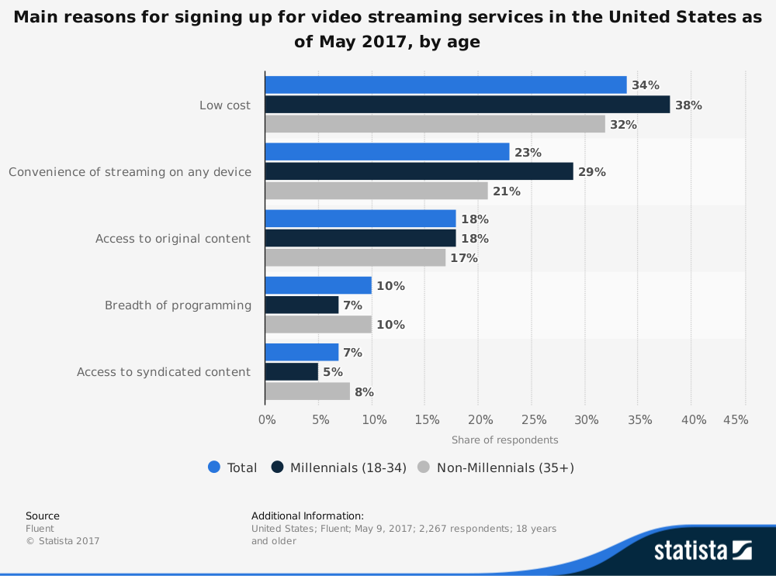

Slide 23
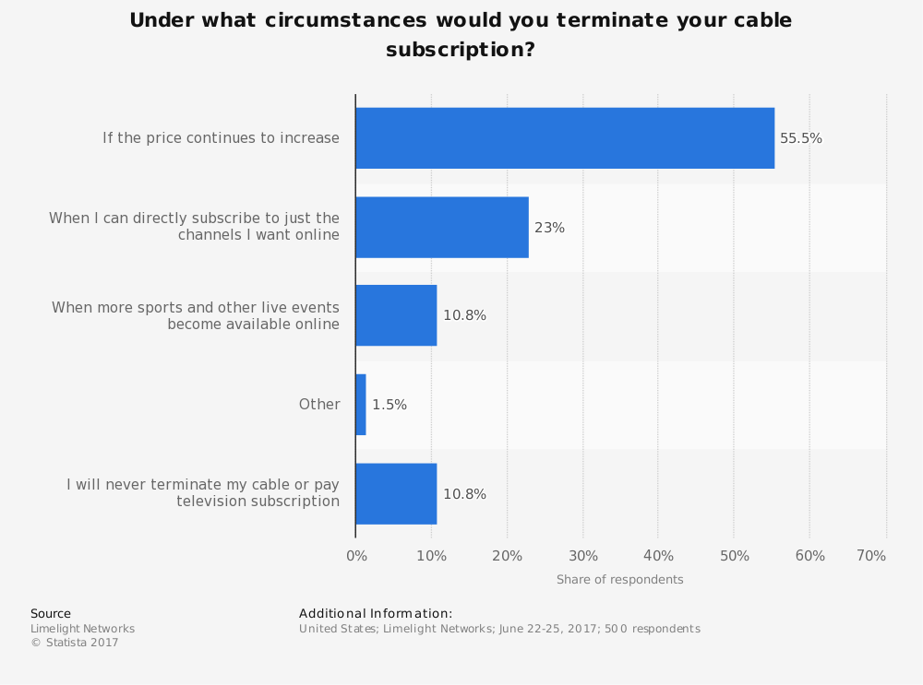

Slide 24
